Slide 1
Temperamental

Slide 2
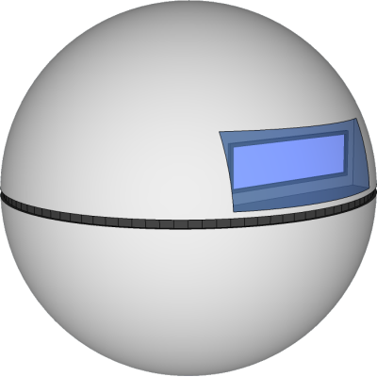
What is Temperamental?
A small spherical device that senses its environment and then complains about it.

Slide 3
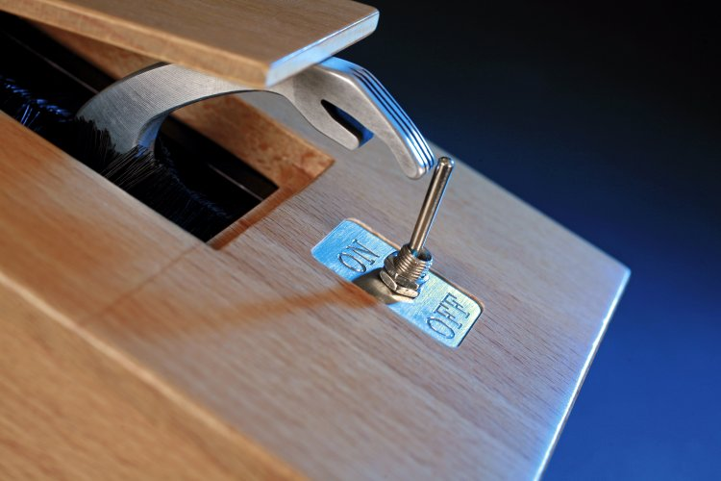
Inspiration
Inspired by Claude Shannon’s ‘Ultimate Machine’
Notes:
Regarded as the “Father of Information Theory”

Slide 4
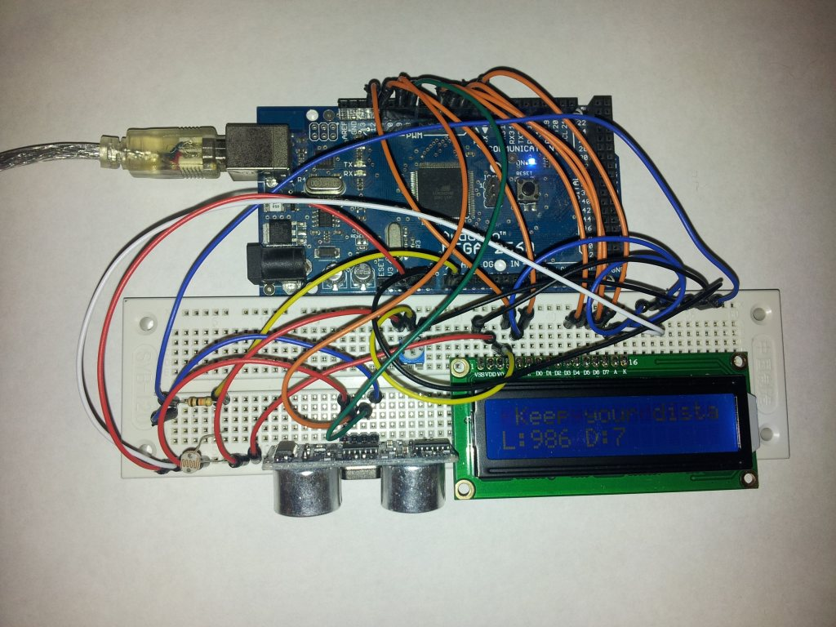
Prototype
We built a working prototype

Slide 5
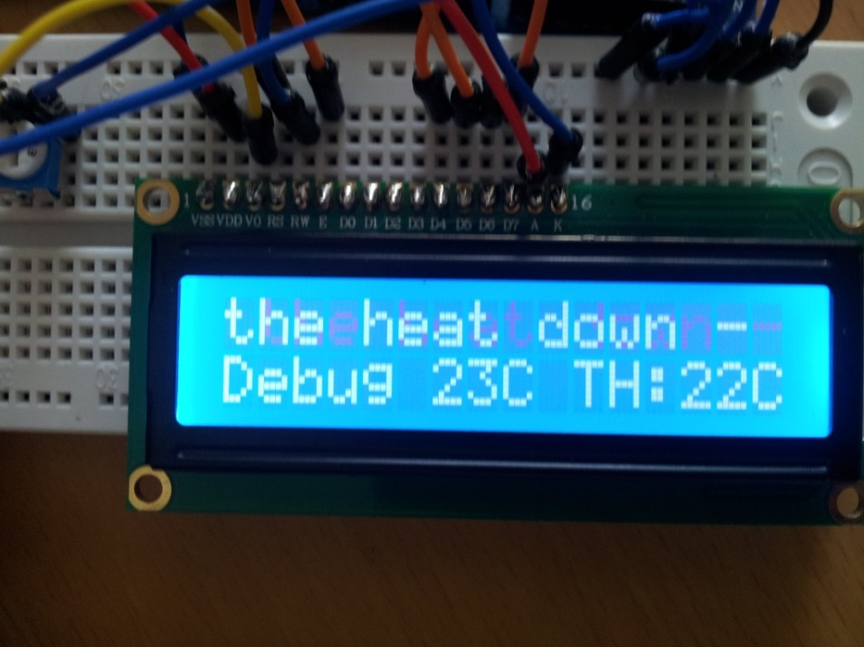
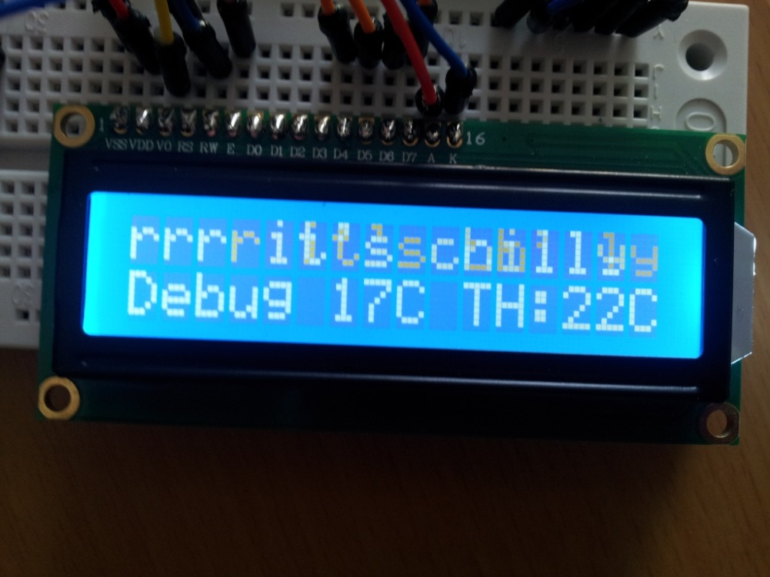

Slide 6
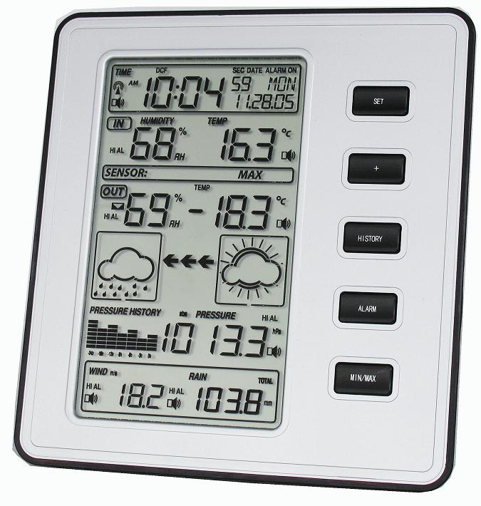
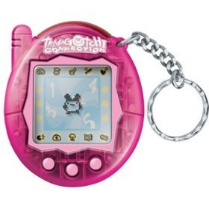
Uses
Toy
Indoor weather station

Slide 7
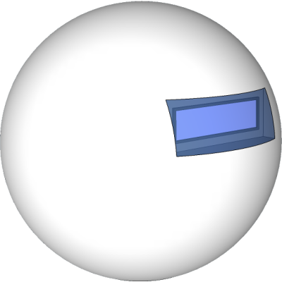
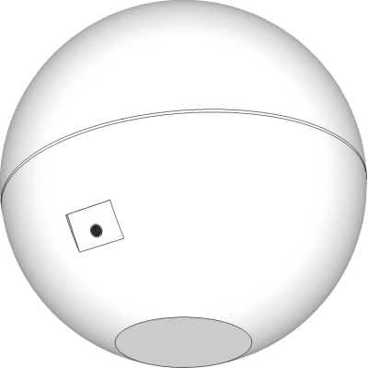
Product Design

Slide 8
Features
Initial Sensors
Internal and External Thermometers
Light sensors
Acceleration
Noise level
Potential Sensors
Pressure
Compass
Rechargeable battery
USB cable/Wifi for updates and sending live data to the website (optional)
Self calibrating

Slide 9
Branding

Slide 10
Website
View live data
View recorded data
Allow public sharing of data
Visualisation of shared data
Connect with social media
Compete with friends

Slide 11
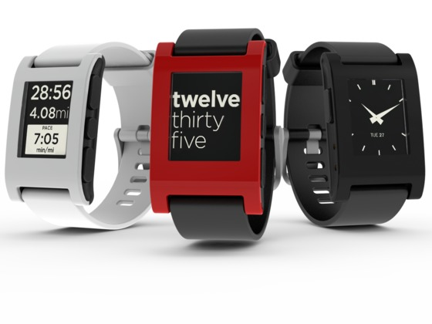
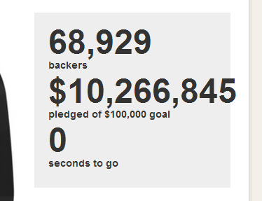
Taking it to market
Phase 1
Build prototypes featuring external shell
Build website
Phase 2
Low risk
Build a customer base before launch
Community feedback
Retaining control over the company
Start social media campaign
Notes:
Pebble Watch – raised $10 Million, 100 times more than the original goal

Slide 12
Taking it to market
Phase 3
Organise manufacturing
Begin selling through website
Communicate with retailers
Phase 4
Expand product range

Slide 13
Market
According to a survey by Tesco Bank the UK will spend a total of £8.5 billion this year.
Mid-High end novelty gifts
No competition

Slide 14
Selling it
Initially the Temperamental will be sold from the website
Retail price of around £30-35
Once proven retailers are more likely to want to stock the product

Slide 15
Thank you for your time

Slide 16
Questions

